Slide 1
Big Mountain Resort (BMR)
Ticket Pricing
Jared Barnes

Slide 2
Identifying the Problem
Many visitors at BMR
each season
BMR added new ski lift to better distribute visitors across the mountain
$1.54 million increase in operating costs

Slide 3
Identifying the Problem
$1.54 million increase in operating costs
Possible Solutions:
Decrease operating costs elsewhere in park
Increase price to new value with new ski lift included
Action Plan:
Identify key features of BMR for future remodel/cutbacks
Calculate new value of ticket based on US ski resort data

Slide 4
Recommendation and Key Findings
Top features of BMR affecting ticket value:
Vertical drop
Snow making
Total chairs
Fast quads
Runs
Longest run
Trams
Skiable terrain
Current ticket price:
$81.00
Recommended ticket price:
$95.87
Recommendations:
Change ticket price to recommended $95.87, more than covering new lift operation costs. If changes, improve only features that increase ticket value.

Slide 5
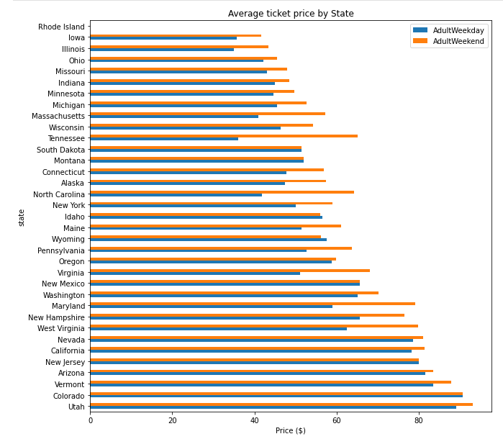
Average Ticket Price by State
Montana’s ticket prices average between $50-$60, while Utah, Colorado, and Vermont average prices are over $80.
Statistics from all states were useful in finding the weights of resort features to average ticket price.

Slide 6
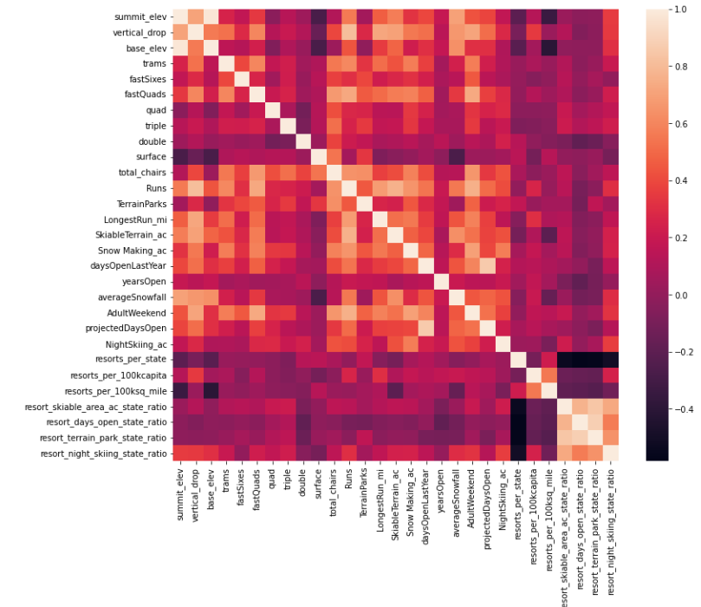
Correlation Between Features
Features weighted strongest for ticket price:
Fast quads
Runs
Snow making
Total chairs

Slide 7
Developing a Model
Less variability in calculations than those of linear regression model.
Linear Regression Model
Random Forest Model
Random Forest Model was the standard model moving forward.

Slide 8
Calculations Using Random Forest Model
Top features of BMR affecting ticket value:
Vertical drop
Snow making
Total chairs
Fast quads
Runs
Longest run
Trams
Skiable terrain
Calculated ticket price,
given BMR features:
$95.87
Calculations were determined using data from all US resorts in the Random Forest Model.

Slide 9
Summary and Conclusion
$1.54 million increase in operating costs
Action Plan:
Identify key features
Calculate new value of ticket
Top features of BMR affecting ticket value:
Vertical drop
Snow making
Total chairs
Fast quads
Runs
Longest run
Trams
Skiable terrain
Recommendations:
Change ticket price to recommended $95.87.
Improve only features that increase ticket value the greatest.
Random Forest
Model
Recommended
ticket price:
$95.87

